Slide 1
Week 3 Wimba

Slide 2
Things I saw in Week 2:
Not downloading the GTT session materials.
Not submitting the proof of participation.
IF you are granted an extension, with or without penalty, that is between you and me, don’t run around telling everyone the details.
Lack of communication:
Asking questions at 11:55 on Thursday.
Not chatting during office hours.
Not asking at all.

Slide 3
Things I saw in Week 2:
NO justification in the Project Justification Video.
Not answering the weekly questions.
These are intended to help you reflect on your work and assist your classmates who may have had the same issues that you did.
It also helps me to see if there is a deficiency in the curriculum.

Slide 4
Things I saw in Project 2:
Bare Minimum – 2 apps, the Bronze app MUST contain a fully functioning CRUD!
Gold app - JQM on everything, should not have been on attItem, JSON or display page
Missing week 1 requirements:
Missing or unattractive Feature/CTA.
Missing value proposition.
Browse Categories are missing.
Search is missing.

Slide 5
Project 2
Getting ahead of yourself!!!!
Not trusting yourself.
Search:
Non-functioning
data-filter=“true”
NOT dynamic, must be included with the section that is to be searched.
jQM filter creates it’s own field.

Slide 6
Project 2
Navigation:
Present, but non-functioning
Not consistent
Only on one app, should be on both
Does not include HOME, INFO or ABOUT, NEWS, etc.
Pages not linking to anything:
Many of the pages were linked to # as placeholders.
Pages are calling non-existing pages.

Slide 7
Project 2
Item Details:
One-Window Drilldown AND List Inlay were required.
Order:
Missing
Backwards
Not adding data-ajax=“false” to the a href call for external pages.

Slide 8
Project 2
Images:
Missing or oddly formatted Thumbnail Grid
Thumbnail Grid, use <br/> to force text to the line below the image.
http://jquerymobile.com/demos/1.2.0/docs/content/content-grids.html
Thumbnail & Text missing

Slide 9
Project 2
What will this produce?
<div class=“ui-grid-b”>
<div class=“ui-block-a”> Block A</div>
<div class=“ui-block-b”> Block B</div>
<div class=“ui-block-c”> Block C</div>
</div> <! - - Closes Grid- - >

Slide 10
Project 2
What about this?
<div class=“ui-grid-b”>
<div class=“ui-block-a”> Block A</div>
<div class=“ui-block-b”> Block B</div>
<div class=“ui-block-c”> Block C</div>
<div class=“ui-block-a”> Block A1</div>
<div class=“ui-block-b”> Block B1</div>
<div class=“ui-block-c”> Block C1</div>
</div> <! - - Closes Grid- - >

Slide 11
Project 2
What about this?
<div class=“ui-grid-b”>
<div class=“ui-block-a”> Block A<a href="error.html" data-ajax="false"><img src="img/blocka.png"/></a>/div>
<div class=“ui-block-b”> Block B<a href="error.html" data-ajax="false""><img src="img/blockb.png"/></a>/div>
<div class=“ui-block-c”> Block C<a href="error.html" data-ajax="false""><img src="img/blockc.png"/></a>/div>
</div> <! - - Closes Grid- - >

Slide 12
Project 2
What about this?
<div class=“ui-grid-b”>
<div class=“ui-block-a”><div class="ui-bar ui-bar-c"> Block A<a href="error.html" data-ajax="false"><img src="img/blocka.png"/></a>/div></div>
<div class=“ui-block-b” ><div class="ui-bar ui-bar-c"> Block B<a href="error.html" data-ajax="false""><img src="img/blockb.png"/></a>/div></div>
<div class=“ui-block-c” ><div class="ui-bar ui-bar-c"> Block C<a href="error.html" data-ajax="false""><img src="img/blockc.png"/></a>/div></div>
</div> <! - - Closes Grid- - >

Slide 13
Project 2
Organization:
While HTML files do not belong in a folder, there should only be 2 html files – index and additem
JQM is specifically designed so that all pages are in one file. **
Git Issues:
Links not included
Branches are not in sync**

Slide 14
Project 3

Slide 15
Form Basics (pgs 341 – 343)
Make sure the user understands what’s being asked for and why.
Avoid asking questions:
Autocompletion
Input Prompts**
Good Defaults
Notes:
Use labels, plain language for novice or occasional users, carefully chosen jargon or specialized vocab for domain experts.

Slide 16
Form Basics (pgs 341 – 343)
Provide lists from which the user can make choices.
Dropdown Chooser
Combo boxes
Lists
Input Hints**

Slide 17
Form Basics (pgs 341 – 343)
Let the programming dictate the base form.
Usability test-it – Think the old adage, “…can’t see the forest for the trees.”
Your choice of controls will affect the user’s expectations of what is asked for, choose wisely!

Slide 18
Goal and Page Conversions
What do you want the user to do?
Prominent “Done” Buttons
Submit
Done
Send
Buy
Change Record
Luke Wroblewski http://www.lukew.com

Slide 19
Use forms to mistake proof the completion process.
Provide direction
Ensure you receive the desired response
Will ensure that the database receives the format required to complete the task
See pages 345 – 355 for ideas

Slide 20
Poka Yoke Approach
“Japanese approach to 'mistake proofin’ in all aspects of manufacturing, customer service, procurement, etc. It employs visual signals that make mistakes clearly stand out from the rest, or devices that stop an assembly line or process if a part or step is missed. Its older name is baka yoke (fool proofing).”
http://www.businessdictionary.com/definition/poka-yoke.html
Notes:
Project 3: Modifying the create and update pages of your CRUD app to support a Poka Yoke approach to form design, using this weeks design patterns.

Slide 21
Poka Yoke Approach
From Wikipedia, the free encyclopedia Poka-yoke (ポカヨケ?)
“Poka-yoke [poka yo-ke] is a Japanese term that means ‘fail-safing’ or ‘mistake-proofing’.”
http://en.wikipedia.org/wiki/Poka-yoke
Notes:
Project 3: Modifying the create and update pages of your CRUD app to support a Poka Yoke approach to form design, using this weeks design patterns.

Slide 22
Proof of Participation
Send an email
telling me what
Poka Yoke means.

Slide 24
Project 3 Requirements
You must have 2 DIFFERENT Forms:
GOLD - MUST be pure JQM and MUST use the sample-main.js
BRONZE - MUST be your VFW fully functioning CRUD, do NOT add JQM to your Bronze form unless you KNOW that you a fully functioning CRUD in your Gold app!
If you do not have this, you WILL receive a ZERO!

Slide 25
Project 3 Requirements
Form Selections: (You must have a minimum of 2 in each app.)
Input Hints (pgs 364 -368)*
Input Prompts (pgs 369 – 371)*
Dropdown Chooser (pgs 380 – 383)

Slide 26
Project 3 Requirements
Good Defaults (pgs 385 – 387):
Range slider
Date-field (there is a plugin for this)
Checkbox elements

Slide 27
Project 3 Requirements
Prominent Done Button (pgs 257 – 261)
Remember that the video placement is incorrect!
Same-Page Error Messages (pgs 388 – 391)
Be sure that the user knows which fields are required BEFORE he presses the Prominent Done Button.

Slide 28
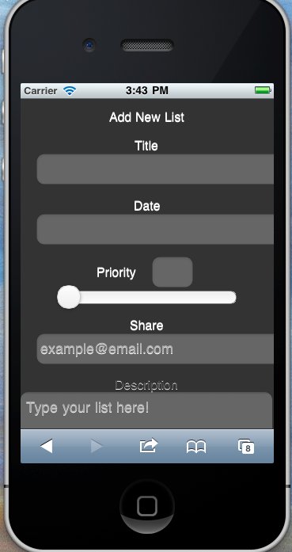
Input Hints (pgs 364 – 368)
Text that is beside or below an empty text field that explains what is required.
Notes:
Brandon

Slide 29
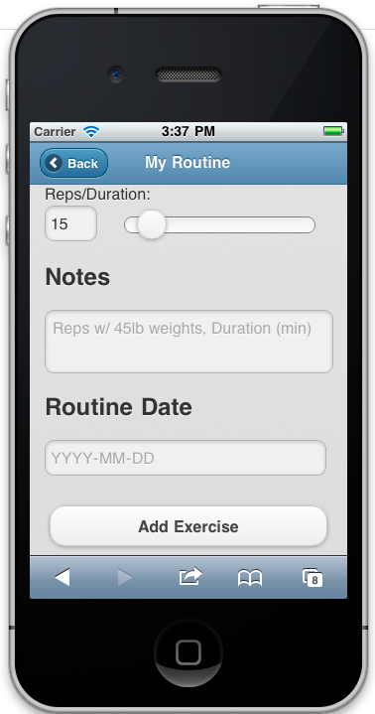
Input Prompts (pgs 369 – 371)
A text field or drop down with a prefilled prompt that tells the user what to do or type.
Notes:
Rueben

Slide 30
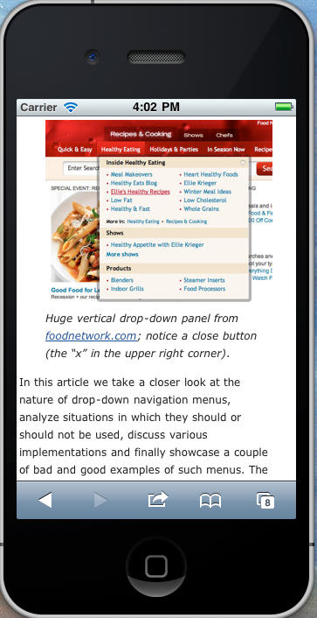
Dropdown Chooser (pgs 380 – 383)
Use a dropdown or pop-up panel to contain more complex UI value selections.
These can include calendars and time choosers.
Notes:
Smashing

Slide 31
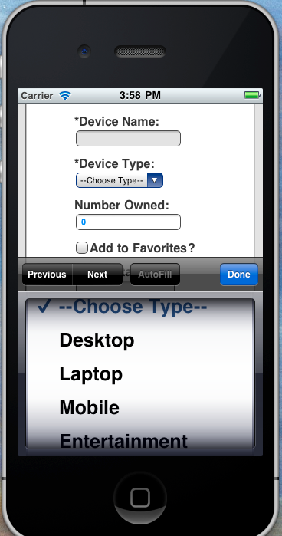
Dropdown Chooser (pgs 380 – 383)
I will accept a spinner as the fulfillment of dropdown; however, remember that the drawback is that you typically do not see all of the selections in one screen.
Notes:
Mike

Slide 32
Good Defaults (pgs 385 – 387)
These should be appropriate, your best guess as to what the user will enter.
Notes:
Rueben

Slide 33
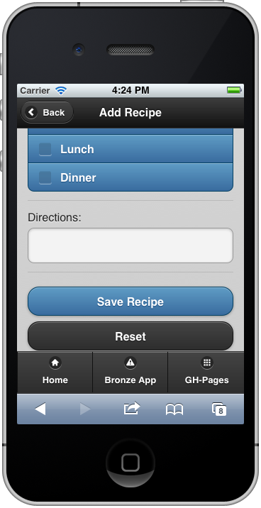
Prominent Done Button (pgs 257 – 261)
Should be at the end of the visual flow and away from secondary actions.
CAUTION: Mike Smotherman is an amazing programmer and produces wonderful videos; however, he is NOT a UI expert. Please follow his video for code and NOT for placement of your buttons.
Notes:
Ryan

Slide 34
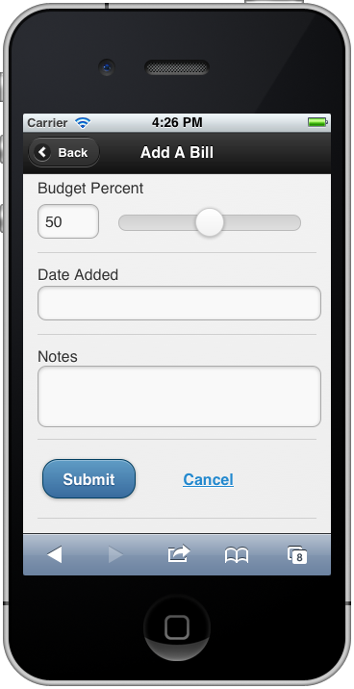
Prominent Done Button (pgs 257 – 261)
Should be at the end of the visual flow and away from secondary actions.
Notes:
Ryan

Slide 35
Changes to: the form the main.js

Slide 36
Changes to the form
REMOVE method="post” GOLD ONLY
<form action="" id=”addForm">
It is used if we were passing the form data to a php or asp file, but we are using JS for everything.

Slide 37
Changes to the main.js
Implement the sample-main.js
The sample-main.js template is in the activity.
You MUST use this main in your Gold app!

Slide 38
Changes to Main.js (cont.)
Start with a NEW Main.js
The Video shows:
$(document).ready()
{
};
The jquerymobile site shows:
$(document).bind(‘pageinit’, function() {
};
Notes:
Ryan

Slide 39
To prepare for jQuery in ASD:
$('#addItem').on('pageinit', function(){
var myForm = $('#formId');
myForm.validate({
invalidHandler: function(form, validator) {
},
submitHandler: function() {
var data = myForm.serializeArray();
storeData(data);
}
});
//any other code needed for addItem page goes here
});
Notes:
Ryan

Slide 40
Changes to Main.js (cont.)
REMOVE TOGGLE function: GOLD ONLY
The toggle function hides the form in certain scenarios (when displaying data for example) and then shows it again if one of those items needs to be edited.
Since the form is on the home page, we don’t have to hide either one; it’s automatic.

Slide 41
Toggle (cont.)…
If you leave it, assuming your code is structured correctly, you could technically tell that page not to be visible, but if you’re not on that jQM page, we won't see it regardless.
We're talking to elements that don't exist on the page on which we would be looking, so why tell the form to hide if it's not in the way?

Slide 42
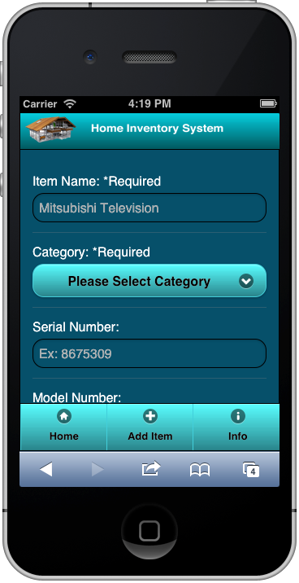
Same Page Error Messages (pgs 388 – 391)
BEFORE you can tell the user which field he has missed, you MUST tell him which fields are required!

Slide 43
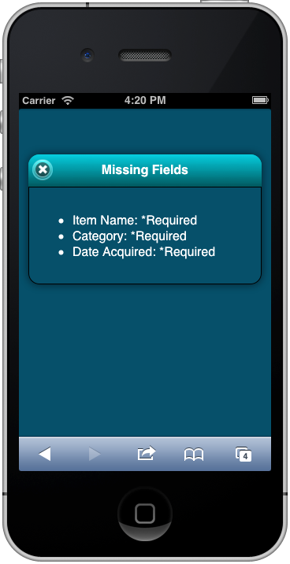
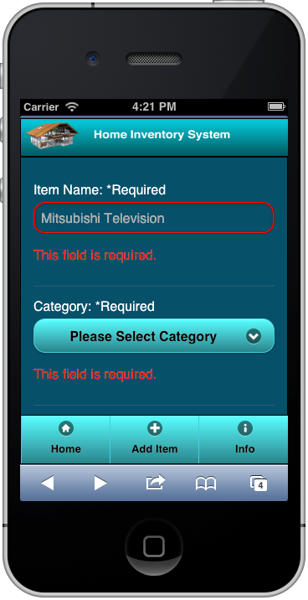
Same Page Error Messages
Should be at the top of the page with indicators on the fields. BE GENTLE!

Slide 44
Deliverables
Two live links to your code:
Repository at GitHub
Working live (clickable) link to the project source code (from your master branch) on GitHub.com
Live code at GitHub
Working live (clickable) link to the live code (from your gh-pages branch) on GitHub.com

Slide 45
Deliverables (cont.)
Two apps:
Your “GOLD” app. – validate and save only
This is your JQM app and should be the one that you feel is the most usable.
Your “BRONZE” app – must be fully functioning.
This is the app in which you apply utilize your VFW CRUD and has patterns that you are not certain work for your app.

Slide 46
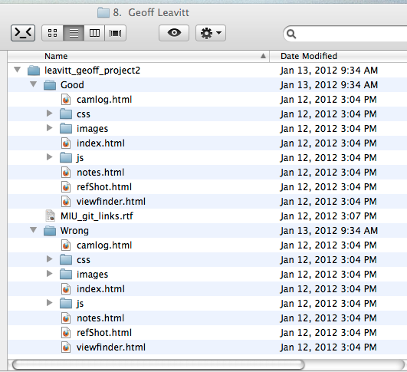
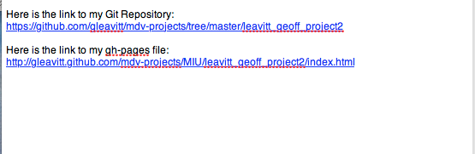
Deliverables (cont.)
File Naming
Clickable Files

Slide 47
Project 4

Slide 48
What’s coming up? Project 4
Visual Enhancements
Few Hues, Many Values
Deep Background
Streamlined Branding
Everything Else from weeks 1-3
Search
Navigation
Newsstream
Everything working

